Slide 1
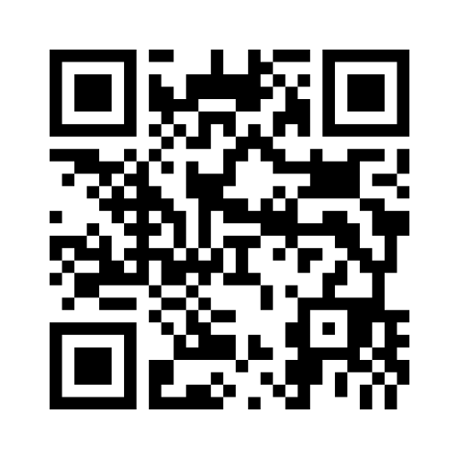
Pre Diabetes
Menti
Questionnaire

Slide 2
The following results indicate the presence of prediabetes:
Fasting plasma glucose: 6.0 mmol/L to 6.9 mmol/L
HbA1c: 42 to 47 mmol/mol (6.0 to 6.4%)

Slide 3
Risk factors
You should be tested for prediabetes if you:
Are overweight or obese BMI > 25
Have a close relative (parent or sibling) who currently has or has had diabetes
Have high blood pressure, low HDL ('good' cholesterol) or high triglycerides
Are over the age of 40
Have given birth to a baby who weighed over 9 pounds or had gestational diabetes .
While pre-diabetes may affect anyone, of any age, gender or racial type, some groups are genetically more prone. These include:
Afro-Caribbean
South Asian
Native American

Slide 4
How to prevent diabetes
Each year in the UK, 5% to 10% of people diagnosed with prediabetes go on to develop type 2 diabetes.
The two principle factors for consideration are:
Making changes to your diet and
Appropriate physical exercise to your lifestyle
By making these changes, blood sugar levels can be returned to normal.
In fact, the recently completed Diabetes Prevention Program study conclusively showed that people with borderline diabetes can prevent the development of type 2 diabetes by making dietary changes and increasing their level of physical activity.

Slide 5
Asian Diet
Traditional Asian diets have some health benefits as well as some risks when it comes to diabetes.
Asian Diet Benefits: •Green tea •Rich variety of vegetables and fruits •Spices •Low red meat consumption •Beans and nuts •Fish and seafood •Fruits as dessert •Whole grains •Tradition of controlling portion size •Soy consumption

Slide 6
Asian Diet Risks
•White rice and other refined grains
•Use of animal fat and palm oil
•Unhealthy trans fats (in snacks, butter, etc.) are not labeled on packages⁵
•Sweets and snacks high in sugar
•Tea or coffee with too much added sugar
•Too much salt
•Excessive consumption of preserved foods (such as pickled vegetables and cured meats)

Slide 7
Diet advice
Structured education program
https://www.diabetes.org.uk/Guide-to-diabetes/Enjoy-food/Eating-with-diabetes/vegetarian-diets/

Slide 9
Exercise
30 minutes at least 5 times a week.
NHS gym referral
Walking , jogging , climbing stairs
Try to enjoy it !

Slide 10
Regular check
Blood test at least every 6 months , earlier if poorly control diabetes, Hba1c >58, kidney function , liver , cholesterol.
Retinopathy screening once a year.
Foot check regularly at home and once a year with HCA.
BP check once a year if controlled,
Flu jab in September

Slide 11
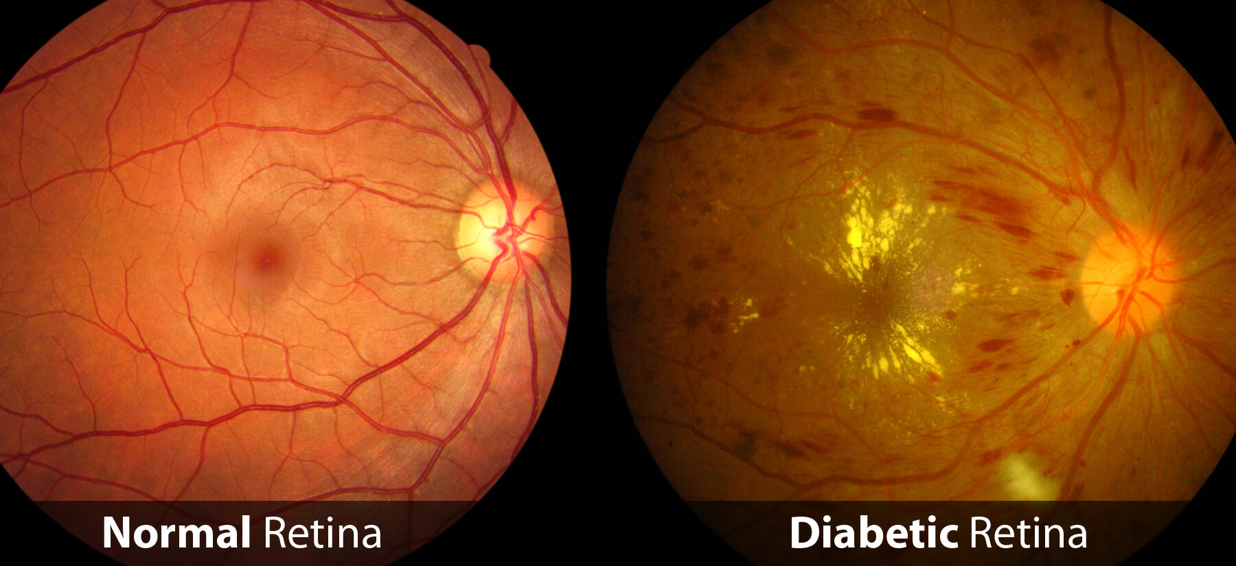
Why we check- eyes
Eye checks- high sugar levels damages the back of the eyes (retina) which leads to diabetic retinopathy. This can lead to blindness
Notes:
controlling your blood sugar, blood pressure and cholesterol levels
taking your diabetes medicine as prescribed
attending all your screening appointments
getting medical advice quickly if you notice any changes to your vision
maintaining a healthy weight, eating a healthy, balanced diet, exercising regularly and stopping smoking

Slide 12
Why we check – feet
Feet checks- high sugars can lead to diabetic neuropathy- this is where the nerves in your body, especially your feet are damaged. This means you may not notice if you have damaged your feet
Diabetes also damages the vessels in your legs leading to peripheral vascular disease – causing higher risk of ulcers
This can lead to a risk of amputation

Slide 14
Why we check- kidneys
We check your kidney function via blood and urine samples
This is because diabetes can damage your kidneys- this is called diabetic nephropathy
This causes the kidneys to leak and not work as well – protein escapes into the urine
Signs of kidney disease: swollen ankles/ feet, blood in the urine, feeling tired.
Untreated kidney disease may lead to dialysis

Slide 16
Tighter Hba1c control = less long term complications
Target Hba1c < 53mmol/L
If Hba1c >58mmol/l should step up medication
Diabetes complications:
Macrovascular Heart disease, stroke
Microvascular retinopathy , nephropathy , neuropathy.

Slide 18
resources
https://www.diabetes.org.uk/Guide-to-diabetes/Managing-your-diabetes/Education/Type-2-diabetes-and-me/
Diabetes uk
Diabetes .co.uk
http://www.mcb.org.uk/wp-content/uploads/2014/06/Ramadan-and-diabetes-A-guide-for-patients-2013.pdf

Slide 19
Hyperglycaemia glucose > 16mmol/L
Thirst, tiredness , passing more urine.
Dehydration : confusion , thirst , lethargy, very little urine output.

Slide 20
Hypos
If you take insulin or certain oral medications (sulfonureas- gliclazide, glimeprimide) you may be at risk of hypoglycaemia – the sugar in your blood is too low – below 4mmol/l
Causes: not always known but could be related to missing meals, taking too much medication, drinking alcohol, being unwell
Signs: being shaky, sweaty, anxiety, disorientation, going pale, blurry vision
If someone becomes unconscious – call 999

Slide 21
How to treat hypos
Immediately!
Drink sugary drinks
Other sugary products: jelly babies, glucose tablets, fruit juice
Check your blood sugar again after 10-15 mins to make sure it is back above 4mmol/l
If not above then have more fast acting carbohydrates
After you may need to have a snack- sandwich or toast

Slide 22
Support available
https://ilford-and-district.diabetesukgroup.org/
https://www.healthwatchredbridge.co.uk/advice-and-information/2021-09-24/my-type-1-diabetes-free-online-service-support-adults-living-type
https://www.diabetes.org.uk/guide-to-diabetes/enjoy-food/eating-with-diabetes
https://oviva.com/uk/en/programmes/diabetes-support/

